Slide 1

Fall 2023
Master's Program
Thesis Seminar
Guidelines
Department of International Studies

Slide 2
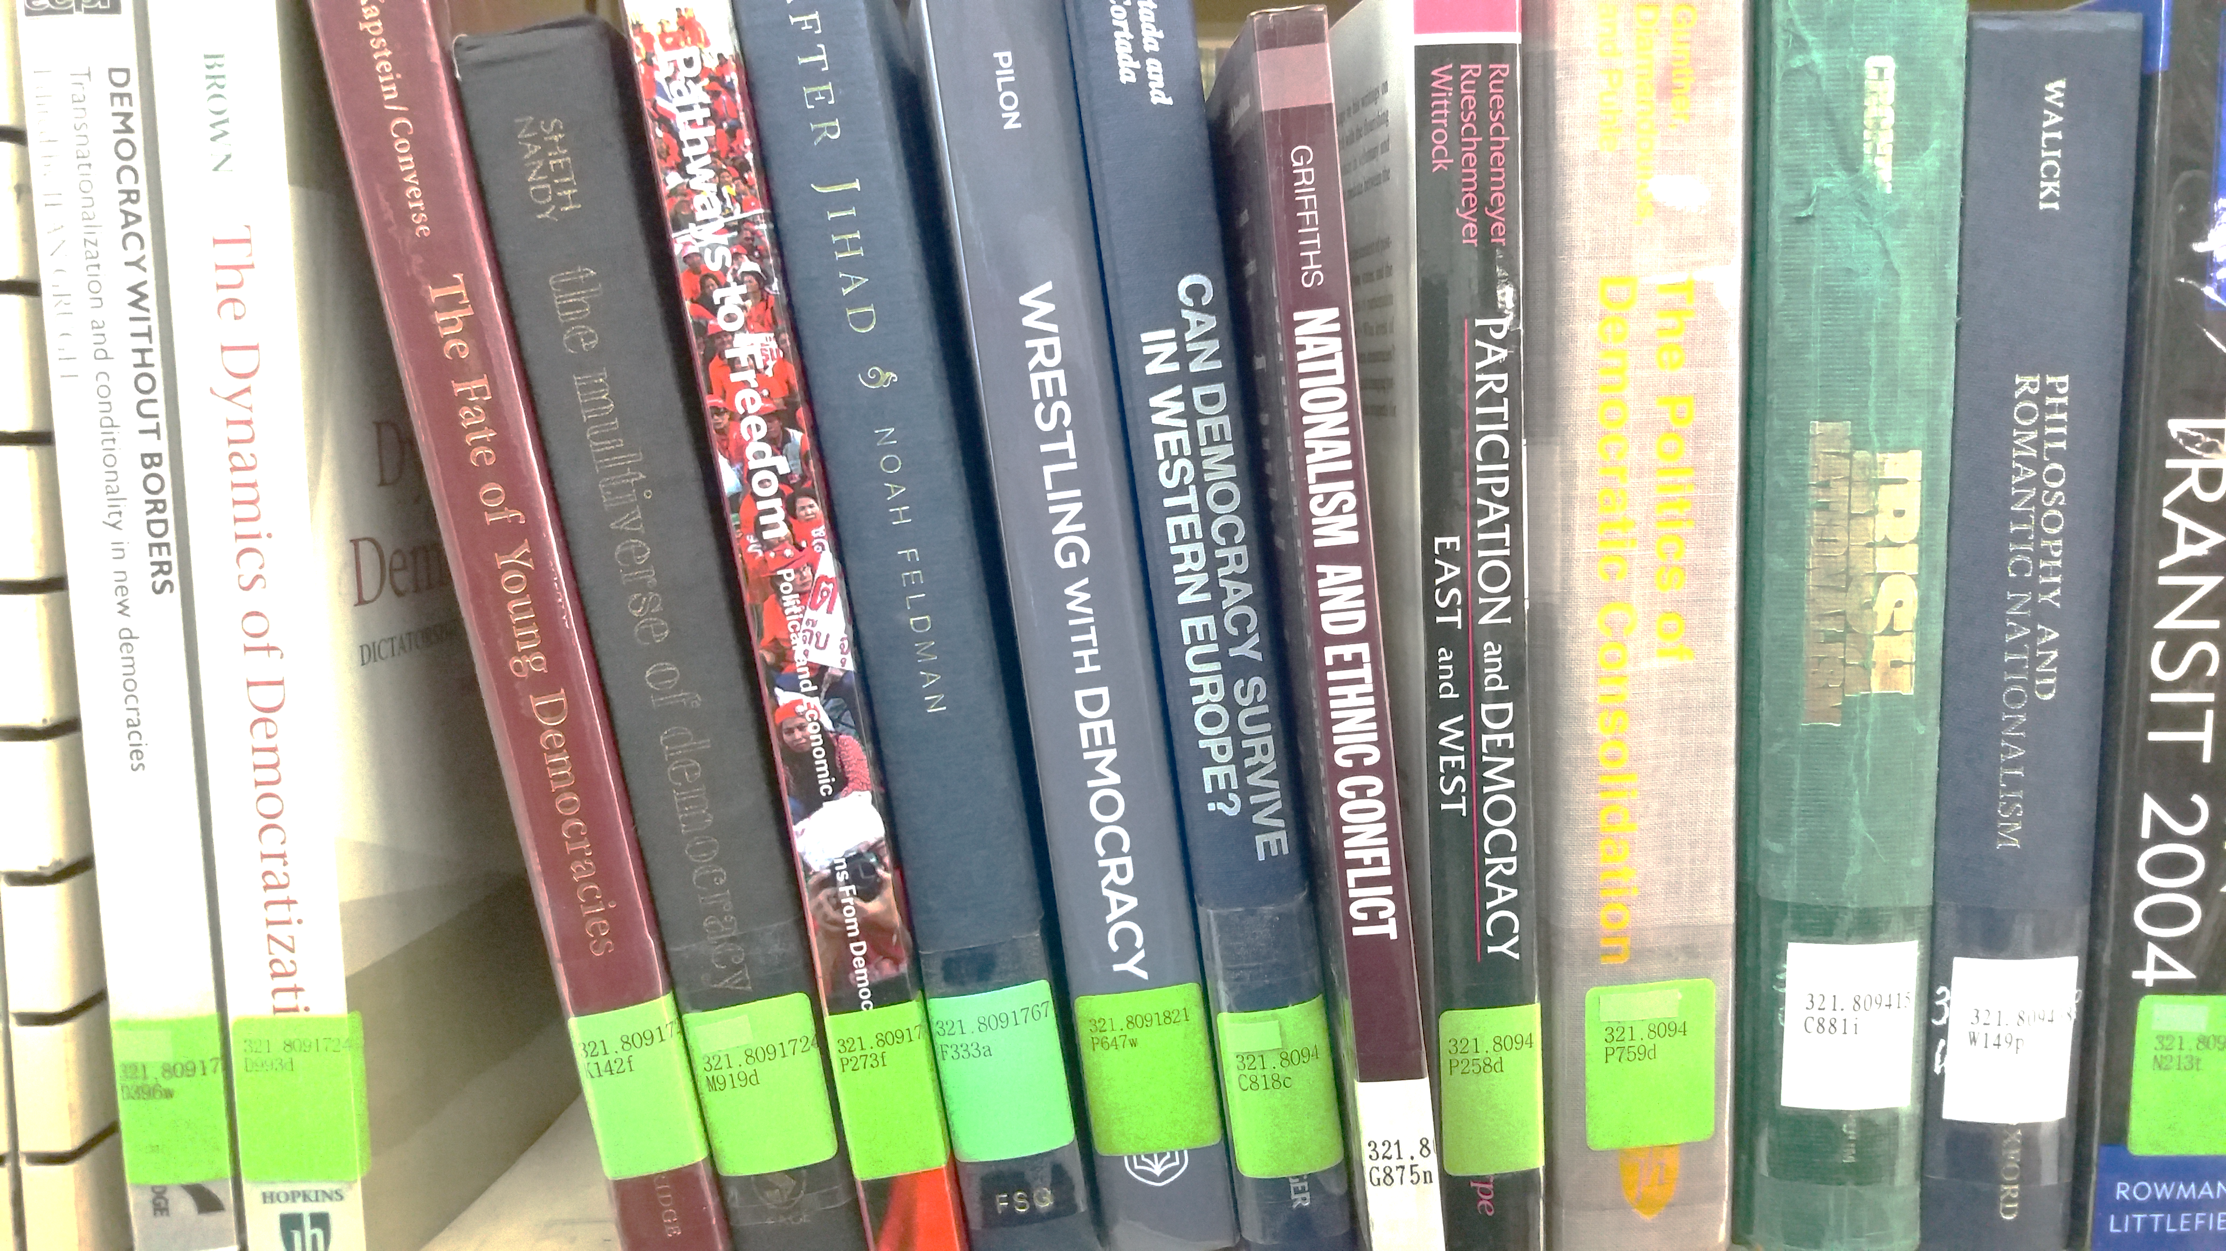

Things you can prepare during the vacation
Complete Research Ethics course via Cyber campus
Required for all thesis-writing students admitted in and after 2014
      Acquire English Proficiency Certificate
Failure to submit the certificate on time (before graduation) will cancel your dissertation submission
Contact thesis advisor. You are going to submit application for thesis advisor appointment and appoint other 2 more professors for your thesis committee (Thesis reviewer and Committee Chair) within October and have permission)
Thesis proposal (5 pages)
Citation : ASA Style 5TH Edition
Table of Contents
MIS Thesis Seminar Roadmap
Schedule & Requirements for MIS Thesis (1) & (2)
The Thesis Font and procedure reminder
Notification on Thesis Advisor Appointment
Evaluation process and Research Question
Information regarding GDIS Citation - ASA Style
Tuition Reimbursement for Cancellation of Thesis-based Registration

Slide 3
I. GDIS MIS Thesis Seminar Roadmap
Sep. 14 (Thur.) 13:00
Submission [GSIS 9-1] Application Form for Thesis, Dissertation Advisor Appointment
Sep. 22 (Fri.) 13:00
Submission for thesis application documents
Nov 10 (Fri.) 13:00
Deadline for
the 1st submission of Thesis for Screening
Dec 8 (Fri.) 13:00
Deadline for
the Final submission of Thesis for Screening
Dec 21 (Thur.)
~ 26 (Tue.)
Final Consultation with Thesis Advisor
Oct. 6 (Fri.)
Submission for the appointment of Thesis Screening Committee via email
Revision Period by Student
Things students can prepare during the vacation
Research Ethics Certificate via Cyber campus
English language test certificate
Contact thesis advisor
Thesis proposal (5 pages)
Evaluation by Master’s Thesis Committee
Dec. 27 (Wed.)
(Tentative, TBC)
Deadline
For the Final Thesis Submission (Online & Hard cover copy)
Oct. 13 (Fri.)
Thesis Screening Committee Announcement by the GDIS office
Nov 13 (Mon.) ~ 24 (Fri.)
The 1st Thesis Evaluation period
Dec 11 (Mon.)
~ 20 (Wed.)
The Final Thesis Screening period
by the Thesis Screening Committee
Before the screening
Thesis Screening Fee payment
* Continued on next page

Slide 4
II. Schedule & Requirements for MIS Thesis (1)
* The following procedures below do not have to be re-taken if done in previous semesters.
Sep. 14 (Thur.) 13:00
Oct 6 (Fri.)
Nov 10 (Fri.) 13:00
Students have to submit below documents (#1-4) to the department office:
1. [GSIS 9-1] Application Form for Thesis, Dissertation Advisor Appointment (This is different from your Academic advisor. Your academic advisor and Thesis advisor could be the same, but you must submit this form to the office.)
1. Thesis Proposal (about 5 pages, including thesis title, by email)
2. [GSIS 9-14] Form of Pledge of Compliance for Research Ethics
3. Research Ethics Certificate via Cyber Campus
* Please check whether you have the requested signatures from you and your thesis advisor on each form accordingly.
The Thesis Screening Committee consists of three faculty members: Thesis Director (Thesis Advisor), Thesis Reviewer and Committee Chair.
During thesis evaluation process, thesis director and reviewer examine student’s thesis and offer guidelines. Committee Chair serves as the head of committee, determining when there are opposite decisions between thesis director and reviewer.
Student must contact individually two more faculties to appoint them as her Reviewer and Committee Chair respectively.
Email the list of the Thesis Committee to gdis@ewha.ac.kr.
Thesis Screening Fee payment can be found on Eureka. (168,000 won for M.I.S.).
- Deadline for the 1st submission of Thesis for Screening (by electronic files). Thesis must be submitted by this date via email. No exceptions.
- Name all the electronic thesis files in a consistent manner: use only the last name of the student and draft number. e.g. Smith [1] - for the first evaluation/ Smith [2] - for the second evaluation
- For students with Korean name, use last and first name initials: e.g. Kim YS [1]
* Notification on Citation Methodology As of 2011, GSIS requires all Master's theses to follow the American Sociological Association (ASA) and citation methodology. Please note that there are few exceptions to the ASA style that should be followed according to the requirements of Ewha Womans University (incl. thesis title page, acknowledgments, abstract, and table of contents).
Sep. 22 (Fri.) 13:00
Before the screening
* Please, prepare and send/ email all the requirements to GDIS prior to the deadline.

Slide 5
II. Schedule & Requirements for MIS Thesis (2)
* The following procedures below do not have to be re-taken if done in previous semesters.
Dec 8 (Fri.) 13:00
Dec 21 (Thur.) ~ 26 (Tue.)
Dec 27 (Wed.)
Tentative
Tentative
- Deadline for the final submission of Thesis for Screening (by electronic files)
- All suggestions and revision requests made by Thesis Committee must be addressed by students for consideration in the Final Screening.
- A Korean language version abstract should be added at the end of the thesis (separate from the English language version abstract at the beginning of the thesis)
- Final Consultation period with Thesis Advisor (by student and if necessary)
- Final check with the Turn-it-in website and discuss the result with your thesis advisor. Request him/ her an approval for the [GSIS 9-21] Thesis Originality Check Confirmation Result Form.
- On-line submission via Ewha Womans University library webpage. After approval for on-line submission, print hard cover copy. & Get the Thesis Committees’ signatures on three hard cover copies.
- Receipt for Thesis Screening Fee payment can be found on Eureka. (168,000 won for M.I.S. / 795,000 won for Ph.D.). Pay the Thesis Screening fee.
*Online submission to Library schedule will be notified later.
Final Thesis Submission Deadline
1. Three hard-cover copies of the thesis including Thesis Screening Committee Signatures obtain by students
2. Author Permission Agreement
3. Confirmation of File Online Submission
4. [GSIS 9-21] Thesis Originality Check Confirmation Result Form
5. Turn-it-in Digital receipt
(Discuss with your thesis advisor about your Turn-it-in result- highlighted phrases & its percentage)
* Further notice regarding Turnitin and online submission will be announced via email.*Hard-cover submission schedule will be notified later.
*Hard-cover submission schedule will be notified later
* Please make sure to complete all the above requirements in advance and submit them with three hard cover-copies to the GDIS office (IEB#1102) before the deadline.

Slide 6

III. The Thesis Font and procedure reminder
IV. Notification on Thesis Advisor Appointment:
In principle, Ewha Full-time faculty (Assistant Professor, Associate Professor and Professor) can serve as a student’s thesis advisor. Faculty who published more than 2 research papers on International Journals or journals acknowledged by Korea Research Foundation during the last 3 years or faculty who has equivalent research record.
Full time faculty who can advise students- at least 4 semesters for master’s students and 6 semesters for doctoral/combined program students - before retirement.
Despite of above regulation, with dean request and president approval, anyone who is qualified can be appointed as thesis advisor. (Please consult with department office in advance, faculty meeting and approval is needed, in such case, all necessary documents needed to be submitted by Sep 14, 2023)
In principle, each faculty member can newly accept 5 master’s students and 3 doctoral students as thesis/dissertation advisees every semester. This limit is on new advisees and does not dictate the total number of students a professor may advise at one time. (Graduate School regulations article 22) Two faculty members may be co-dissertation advisors if both faculty members are on-campus. This requires a special application process.
* Your thesis advisor(director) and thesis screening committee appointment must be done upon each professor’s permission. Therefore, before submitting it to the GDIS office, please contact professor(s) individually in advance.
NOTES :
★ If you do not meet the deadlines as listed before, your thesis WILL NOT be accepted. No exceptions.
★ There is no second revision period: all suggestions and revision requests made by Thesis Committee must be addressed by the student during the revision period
★ Unless members of the committee specifically request hard copies for the two evaluations, electronic copies only should be sent out to protect environment, and hard copies only prepared for the final collection of signatures once the thesis has passed.
Font guideline Summary :
Text Font : Times New Roman (Korean text: 신명조, HY신명조, 휴먼명조, 바탕체)
Title : 14-16 point, Bold
Subtitle : 12-13 point, Bold
Body : 10-11 point
Footnote : 9 point
Space : 160-200%
* We will provide you a full thesis format guideline version in a separate file.
Citation : ASA Style 6TH Edition
You may borrow the style guide hardcopies at the department office. Please visit GSIS office and ask our department TA.
Rental is available up to one month.

Slide 7
V. Evaluation process and Research Question
3) Thesis writing must conform to the required standard.
When the thesis is submitted for evaluation, it must conform to the required standard format, including proper citations, page numbering, spacing, font, margins, etc.
★ Notes:
In terms of “substance” in thesis writing, the main purpose and content of your thesis should be to make a specific and original argument by responding to one (or more) central research question(s).
The central research question(s) will generally be followed by (but not always be limited to) relevant literature review, analysis and conclusion sections with respect to your central research question(s) (e.g., “The research question presented is what economic effect the Bank of Thailand’s monetary policy decision to de-peg its national currency had during the early stages of 1997-98 Asian Financial Crisis.”). In other words, the thesis should directly reflect your own particular and specific position(s) / argument(s).
For clarity, your thesis should also not be a mere overview of the current academic literature (e.g., “An Analysis of Thailand’s Monetary Policies during the 1997-98 Asian Financial Crisis”).
Your thesis must also be directly based on your “original” research (e.g., unique in content/analysis) based mostly on “primary” sources (e.g., government agencies, intergovernmental agencies, etc.), although “secondary” sources (e.g., academic articles, books, newspaper articles, etc.) may also be used to complement primary sources.
Any further related queries can be addressed to your thesis advisor, including (but not limited to) the early stages of your thesis development.
Thesis writing process can be long and frustrating at times, but is also very rewarding.
In order to ensure that the process proceeds smoothly—for both students and faculty—we are implementing new standards and requirements.
1) There will be no extensions for set deadlines.
The date is absolute, meaning under no circumstances will a thesis be accepted for evaluation after deadline. If the student does not submit her thesis by this date, it will not be evaluated until resubmitted the following semester.
2) There will be only two evaluation periods.
a) After the initial evaluation by the Thesis Committee a thesis will be graded according to one of three categories:
- Pass (no corrections necessary)
- Final evaluation only with revisions
- Fail (no final evaluation)
If the committee requires revisions, the student must complete the suggestions, address all issues, and make all editorial/grammatical corrections during the approximately two week revision period.
b) As before, the revised thesis must be submitted to the committee by the due date.
c) The final evaluation will be graded according to two categories only:
- Pass
- Fail
If the student has not made the necessary revisions, or if the thesis is still not at an acceptable standard, the thesis will not be evaluated again until resubmitted the following semester.

Slide 8
VI. Information regarding GDIS Citation - ASA Style
VII. Tuition Reimbursement for Cancellation of Thesis-based Registration
As of 2011, the Graduate School of International Studies is requiring that all Master's theses follow the American Sociological Association (ASA) style and citation methodology.
The ASA style includes not only methods for writing in-text citations and bibliographic references, but also includes guides for margins, line spacing, text font and type, page formatting and text formatting. Among other requirements, the style guide also indicates how headings for tables and figure should be written. Additionally, the guide provides examples of the Mechanics of Style, for example abbreviations and acronym usage, and the writing of compound words, numbers and dates, etc.
The Master's thesis must conform to all of the provided conventions in order to be considered complete.
It is your obligation, therefore, to read the style guide thoroughly and follow all of the style requirements. Please refer to the latest edition: ASA Style Guideline, 6th Edition.
Please note that there are a few exceptions to the ASA style that should be followed according to the requirements of Ewha Womans University, including the thesis title page, acknowledgments, abstract, and table of contents.
We appreciate your diligence in preparing your thesis in accordance to the requirements of the ASA style.
Commented by Professor Willoughby
Applicable for students who complete the coursework and enrolled as thesis-based registration status but will not proceed thesis advising nor screening/submission, needs to withdraw her thesis-based enrollment. (Reimbursed amount vary upon to the date when the printed application form submitted to GSIS main office.)
※ Cancellation process: Login to Ewha Portal→ Open EUREKA → Go to My EUREKA → 논문 등록 취소 신청 →submit the file to GSIS main office
If you have any questions, please contact to the GDIS TA. (gdis@ewha.ac.kr) Thank you.
Submission dates for thesis-based registration cancellation form to GSIS main office | Reimbursed Amount
Within 2 weeks of the start of the semester | Full amount of thesis-based Tuition
Within 30 days of the start of the semester | 5/6 of thesis-based tuition
Within 60 days of the start of the semester | 2/3 of thesis-based tuition
Within 90 days of the start of the semester | 1/2 of thesis-based tuition

