Slide 1
디지털 신호 처리 연구실 (DSPL)
김정태 교수님
박사과정 : 한미선 조희연 최은정
석사 과정 : 채솜이 서지현 김경실 이효림 하태형 박지민
인턴 :오승미

Slide 2
Research areas of interest
Statistical signal processing
Estimation / Detection
Image restoration / reconstruction
Computational photography
Plenoptic image processing, light field reconstruction
Machine learning based machine vision

Slide 3
Ongoing projects
Radar signal processing
Radar signal processing for multiple object tracking – Top Engineering
Machine learning based machine vision algorithm
Image based inspection of camera defects - Top Engineering
Image based recognition of banknote - Puloon Tech.
Intelligent machine vision system for smart factory - NRF

Slide 4
What is Radar?
UWB radar (Ultra wideband radar)
UWB with high distance-resolution (transmits a very short pulse train less than 1 nanosecond)
UWB application
Occupancy detection with movement reduction
People counting with movement pattern analysis
Respiration detection of humans and animals

Slide 5
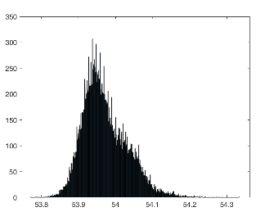
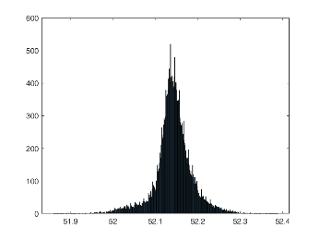
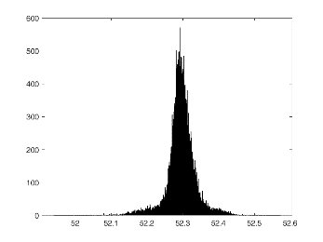
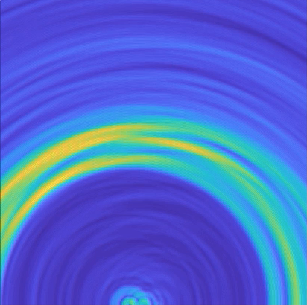
Radar signal processing for multiple object tracking
Radar signal processing for multiple object tracking
Statistical property analysis of radar signal
Noise and clutter reduction based on statistical signal processing
Multiple radar-based 2D multiple target localization
< UWB radar chip>
< Statistical modeling of radar signal >
< Multiple radar basd 2D image generation>

Slide 6
Demo
Tracking of a walking people using algorithm developed by DSPL in comparison with an existing method

Slide 7
What is Machine Learning (ML) and Machine vision?
Artificial Intelligence based inspection of defect, disease, etc.
It is difficult for a human being to repeat the same task without making mistakes
However, for many machine vision tasks, skilled human often outperforms machine vision algorithms (e.g., diagnosis using medical image, inspection of complex shape)
Machine learning based machine vision system learns human being’s way to make decision

Slide 8
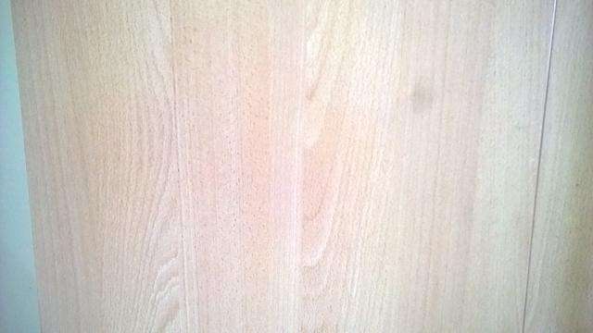
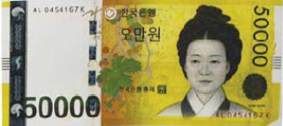
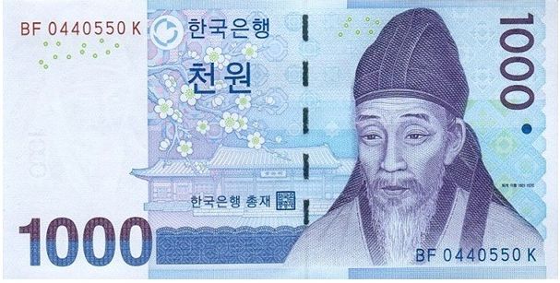
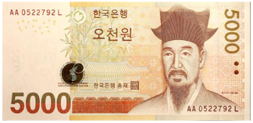
Applications of our project
Defect of Mobile camera
Defect of Display panel
Banknote
< Counterfeit >
< Classification >

Slide 9
ML based stain detection
Stain detection algorithm implementation
Region of interest (ROI) extraction
Classification
Deep learning structure optimization
hyper-parameter optimization based on Bayesian optimization
High speed and high performance
<Stain image>

Slide 10
ML based display panel inspection
Display panel inspection algorithm implementation
Remove background pattern
Detection of defective part
Quantification and classification of defect
High speed and high performance
GPU based CUDA, parallel processing algorithm
<Display panel image>

Slide 11
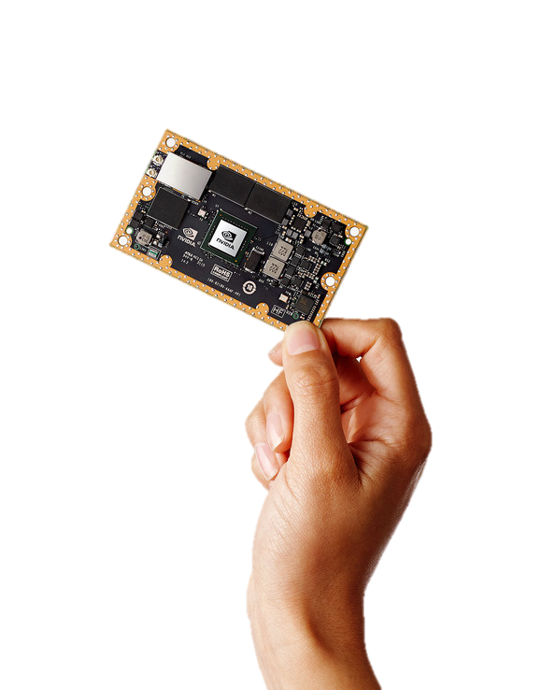
ML based banknote recognition
Banknote recognition algorithm implementation
Serial number recognition
Counterfeit authentication
Banknote edition classification
High speed and high performance
Algorithms using tensorflow, python, CUDA
Banknote recognition algorithms using Embedded GPU
NVDIA XAVIER Embedded GPU board

Slide 12
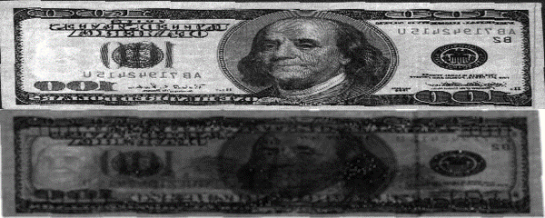
ML based banknote recognition
Serial number recognition
< Serial number image>
Counterfeit authentication
Banknote edition classification
< Counterfeit / Genuine image>
< Multinational banknote image>
위폐
진폐
Input image
Convolution layer1
Convolution layer2
Convolution layer3
Fully-connected
layer1
Fully-connected
layer2
<Counterfeit authentication Deep learning Network >

Slide 13
Future works
Radar signal processing
Advanced statistical model-based filtering for radar signal
Design multiple object tracking algorithm
Machine learning based inspection system
High speed and high performance inspection system based on deep learning
Machine learning based banknote recognition
Banknote recognition algorithms using Embedded GPU
Integrated banknote recognition system optimization

Slide 14
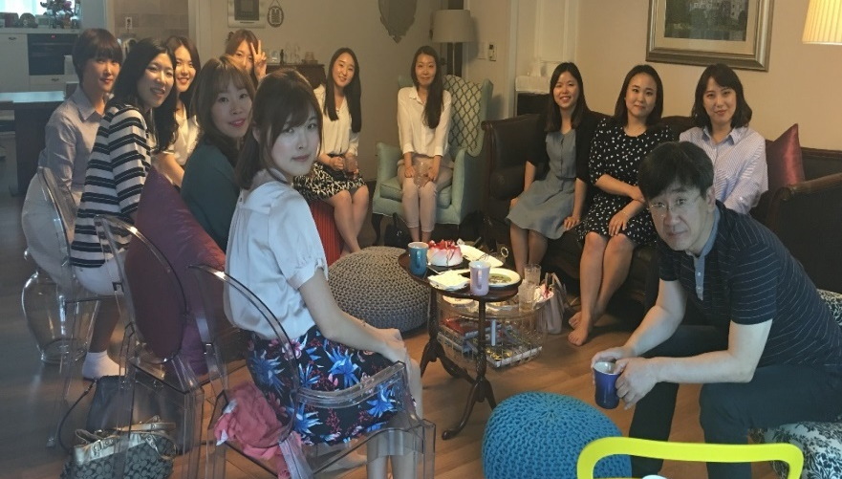
디지털 신호 처리 연구실 (DSPL)
지도 교수님 : 김정태 교수님
연구실 : 아산공학관 423호

Slide 15
대학원 생활에 대해 궁금한 점 있으면 질문해주세요 ☺ 감사합니다 ^.^

